Slide 1

DISEASE DIAGNOSIS USING CHATBOT
RAGHU ENGINEERING COLLEGE
Autonomous
DEPARTMENT OF COMPUTER SCIENCE & ENGINEERING
Presented By
Kakkirala Sai Teja M.Tech CSE (20981D5802)
Under the guidance of
Dr. R. Sivaranjani
-Professor

Slide 2
Introduction
Overview of Remote Diagnosis Systems
Growing popularity and accuracy
Benefits: cost-effective, fast, reliable
Supports medical diagnostics, treatment, and prevention
Supports medical diagnostics, treatment, and prevention

Slide 3
Project Goal
Objective:
Create an affordable, accessible, all-day chatbot for health monitoring
Enable users to check their health anytime

Slide 4
Features of the Chatbot
Key Features
Free and Easy to Access
Saves on Consultation Costs and Time
24/7 Availability

Slide 5
Technology Stack
Python : programming language
Modules
Tensorflow
Numpy
Pandas
Matplotlib
Scikit – learn

Slide 6
Implementation Process
Text Processing
Chatbot processes user input, extracts keywords using NLP
Conversation Flow
Chatbot leads conversation by asking relevant questions, identifies potential diseases

Slide 7
Algorithms For Chatbot
NLP (Natural language processing) and Machine Learning are both fields in computer science related to AI (Artificial Intelligence).
Decision Tree Algorithm
Similarity Ranking Method

Slide 8
Disease Detection and Recommendations
Detection & Recommendations:
Disease Listing: Based on collected data
Remedies and Medications: Suggested by chatbot
Doctor Referrals: Redirects users to medical professionals if necessary

Slide 9
Advantages of the Chatbot
Accessibility: Available anywhere, anytime
Cost Savings: Reduces the need for initial consultations
Time Efficiency: Immediate responses and recommendations

Slide 10
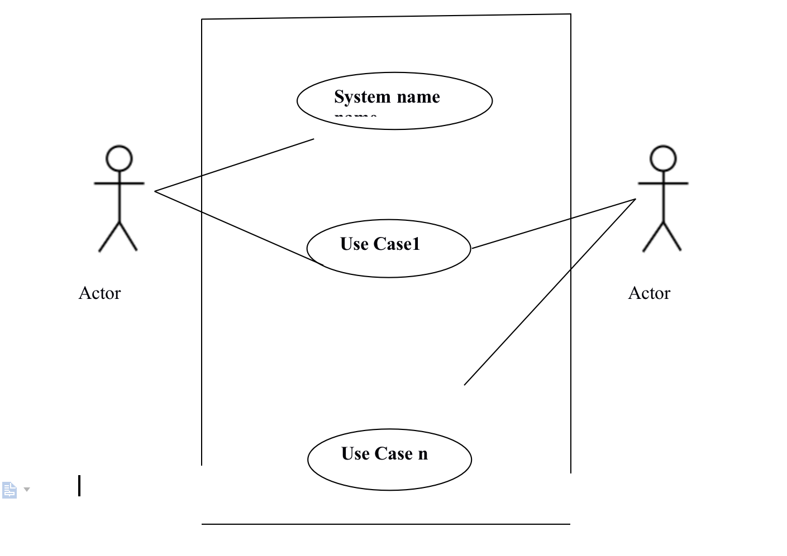
Use Case Model

Slide 11
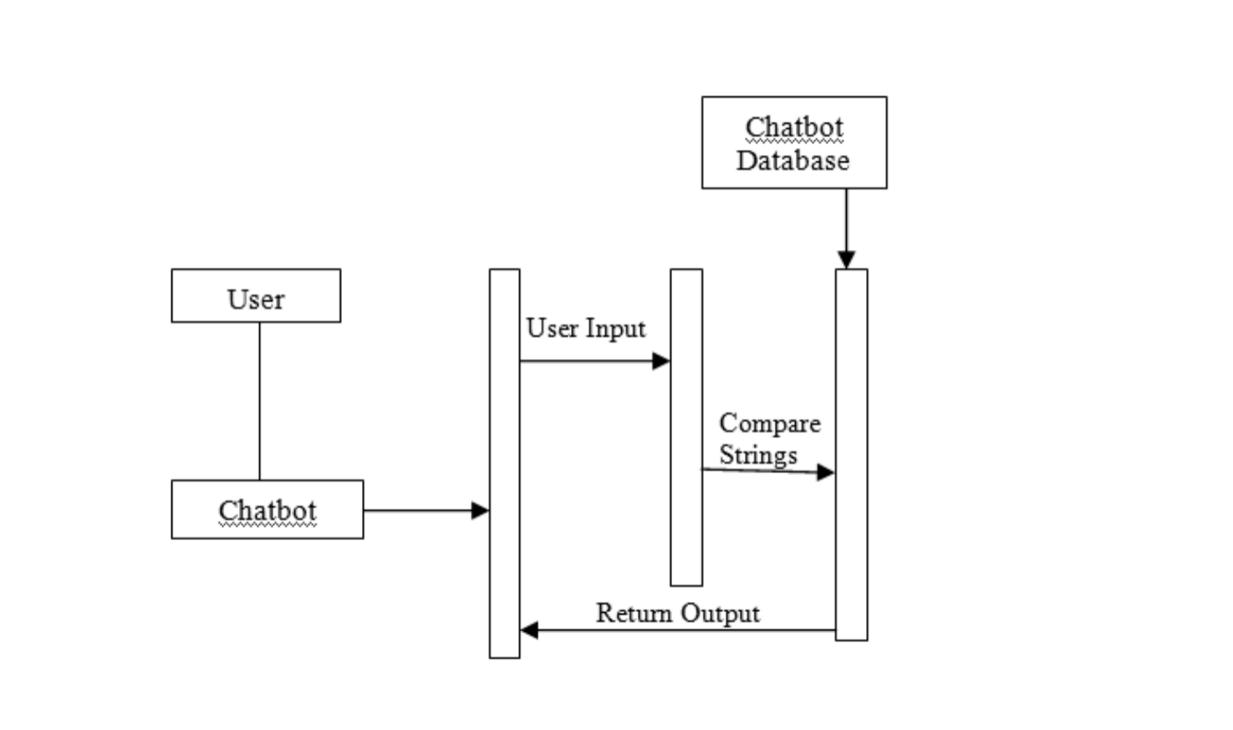
Collaboration Diagram

Slide 12
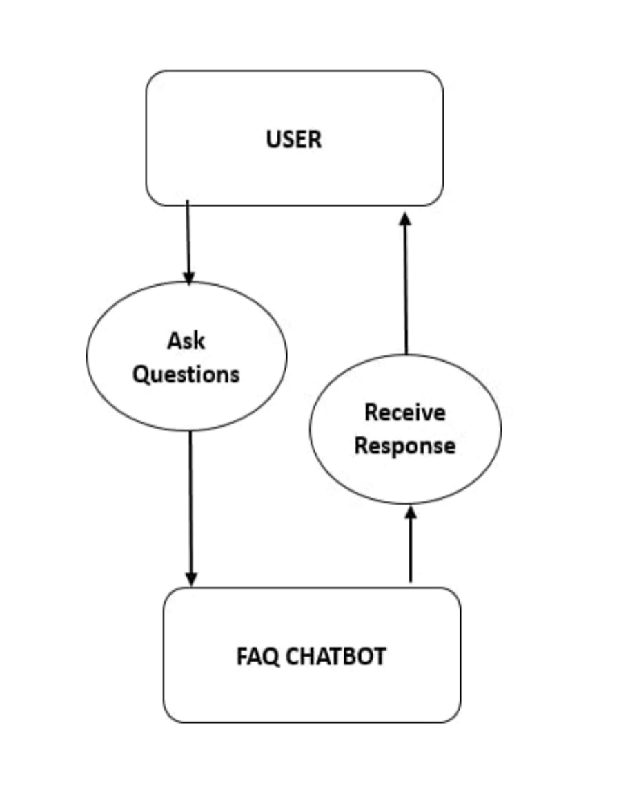
State Chart Diagram

Slide 13
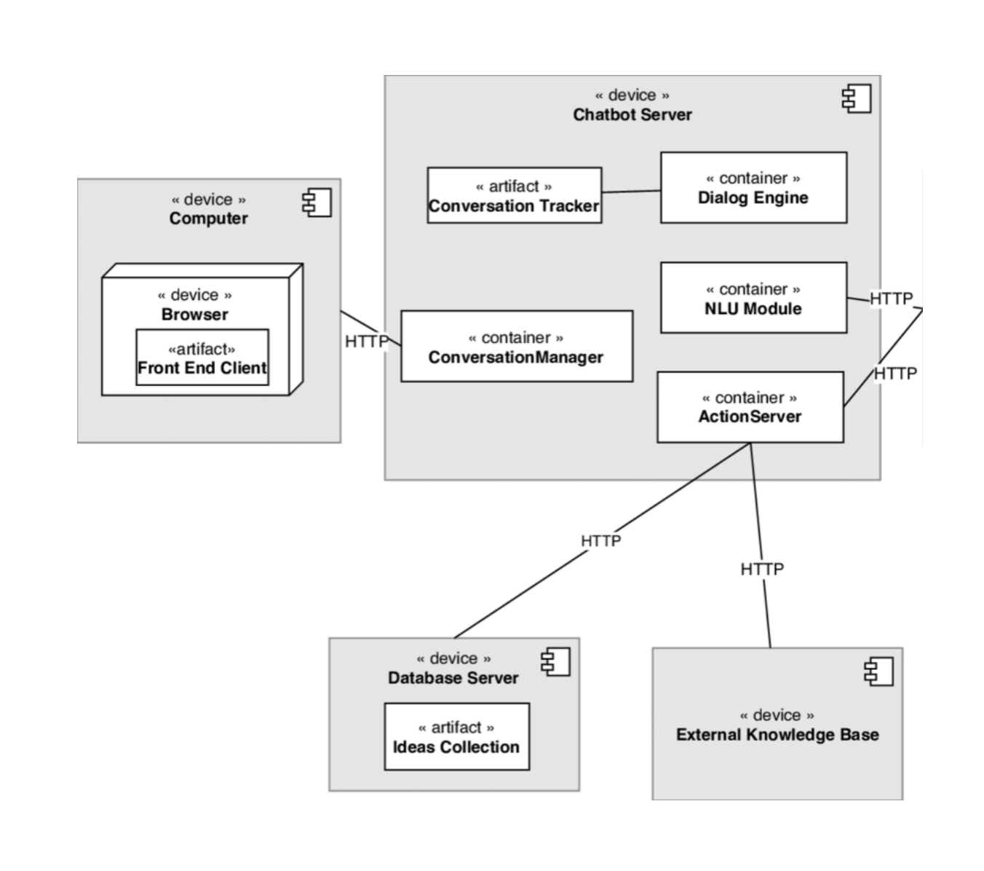
Deployment Diagram

Slide 14
Conclusion
Summary:
An innovative approach to remote diagnosis using AI
Future Scope:
Enhancements in diagnosis accuracy and integration with more medical databases

Slide 15
THANK YOU

